Slide 1
Rapid Prototyping
Rapid adj.
marked by a fast rate of motion, activity, succession, or occurrence

Slide 2
What is prototyping?
How can I use it in my work?
Is it any different from testing?
Notes:
These are the three questions that this presentation should answer. It’s the first slide so that we can set expectations.

Slide 3
other
We interact with prototypes every day
^
Before we buy a book, we read the back of the cover for the teaser
At the store, the changing rooms give you a chance to try the piece of clothing or shoe
When we go on dates, we eat some of the other person’s meal
Notes:
This helps people think about prototyping as part of their daily life. It can also invite debate – and the last point is set up for comic relief.

Slide 4
What’s the purpose of a prototype?
communication: ideas can be frightening, and the basic concept difficult to grasp
feedback and ideation: talking about an abstract idea can be difficult
agreement: long emails and documents are continuously iterative because the concept is not concrete – how many times have you deliberated business requirements?
Notes:
This slide is put in on purpose. We can put this in the context of business requirements vs business outcomes.

Slide 5
When do you need a prototype?
what if….?
how would it look if…?
if is a good place to start: our imaginative senses have different inspirations and so create different mental images, once you start ideating it’s time to prototype

Slide 6
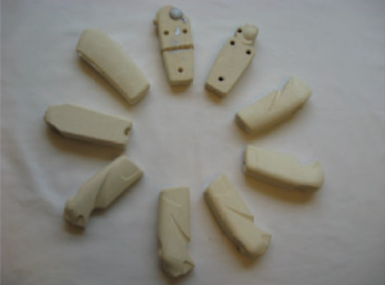
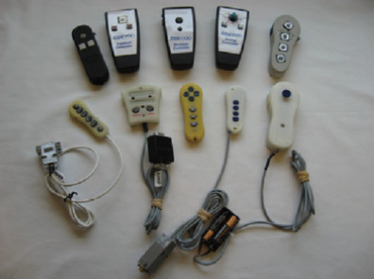
There are different types?
looks-like
works-like
the objective is for the product to merge both, but prototypes focus on either.
Notes:
These are the two basic types of prototypes, culled from product design. One is about how the product looks, the other about how the product works. The pictures show prototypes for a remote control device.
In this part of the presentation, the objective is to have a conversation about why the prototypes are different – and what both do differently. When in doubt, go for works-like.

Slide 7
the crappier the prototype, the better
but
it needs to communicate what is new about the idea
different
Notes:
Don’t be afraid to jump in – communicating the idea in its crude form helps foster better ideation

Slide 8
2D sketching – at scale or freehand / paper cutting / scrapbooking / cartooning
3D CAD / foam core or paper / tape
4D video / role play / scenario building / experimentation
constraints make prototyping more interesting
Notes:
Prototypes can take different forms, it helps to classify them in terms of dimensions.

Slide 9
What is different about the idea?
an experience? reading a photobook
a user action? filling out an online form
the service offering? 300 Slater reception
a call handling technique? an agitated client
Notes:
Another conversation slide. The four examples here will be explored deeper in the following slides – the one highlighted in red will be prototyped as part of the presentation.

Slide 10
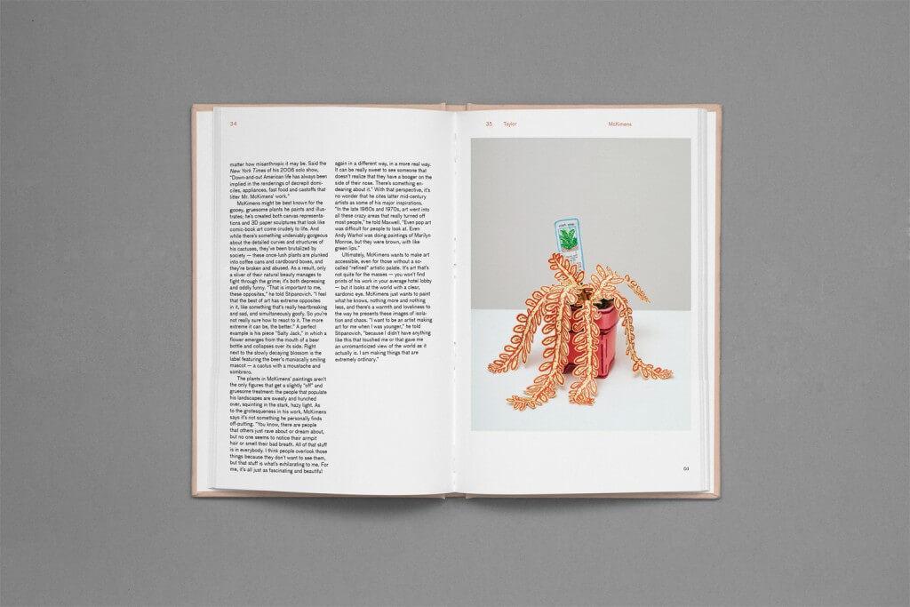
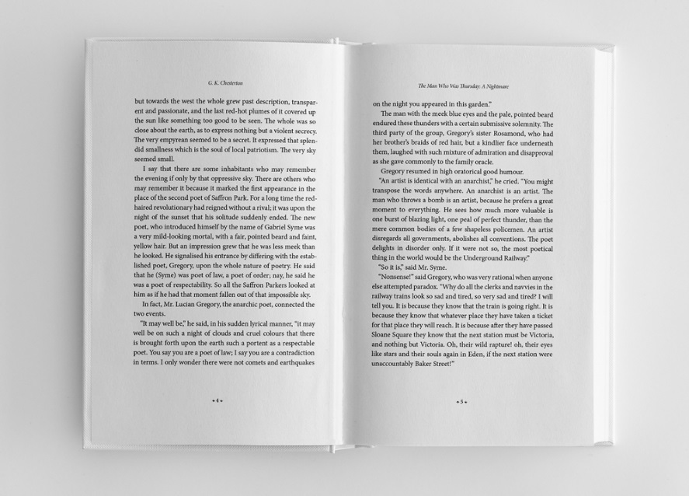
1
an experience
Scenario:
Photobooks are written much in the same way as books with text and typically with the pictures on a different page as the descriptions. How could this be improved and how to show this?
Notes:
Another conversation slide. The four examples here will be explored deeper in the following slides – the one highlighted in red will be prototyped as part of the presentation.

Slide 11
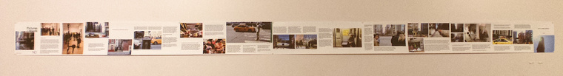
1
an experience
Prototype:
A horizontal display.
Notes:
Another conversation slide. The four examples here will be explored deeper in the following slides – the one highlighted in red will be prototyped as part of the presentation.

Slide 12

2
a user action
Scenario:
We are debating adding a new online service where people could see what mental health services are in their vicinity, how could we prototype this?
Notes:
Another conversation slide. The four examples here will be explored deeper in the following slides – the one highlighted in red will be prototyped as part of the presentation.

Slide 13
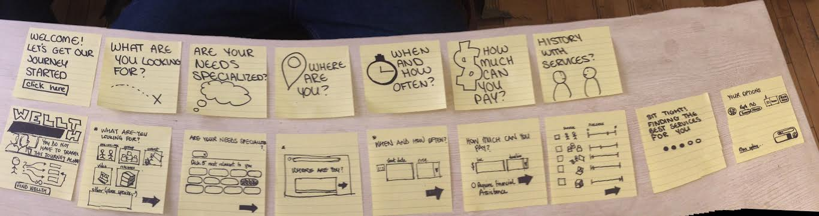
2
a user action
Prototype:
A page-by-page walkthrough that shows the objective of the tool.
Notes:
Another conversation slide. The four examples here will be explored deeper in the following slides – the one highlighted in red will be prototyped as part of the presentation.

Slide 14


3
an operating procedure
Scenario:
More clients are calling about a particular issue and we have prepared a script to inform them. But more and more are becoming agitated, how do we prepare a more robust approach?
Notes:
Another conversation slide. The four examples here will be explored deeper in the following slides – the one highlighted in red will be prototyped as part of the presentation.

Slide 15
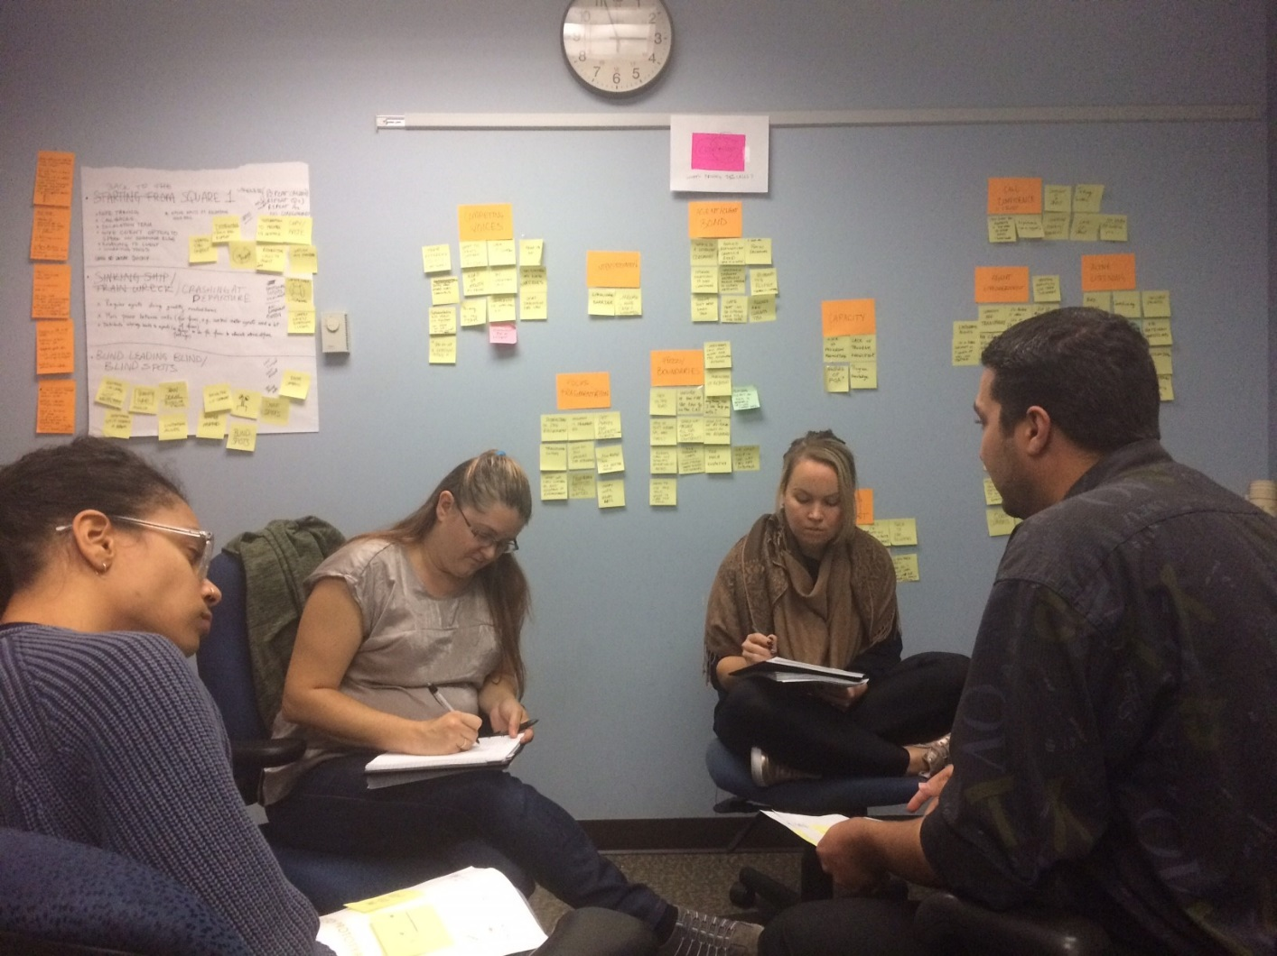
3
an operating procedure
Prototype:
A role-play session where two actors improvise and watchers take note on themes.
Notes:
Another conversation slide. The four examples here will be explored deeper in the following slides – the one highlighted in red will be prototyped as part of the presentation.

Slide 16
*
exercise – a service offering
Scenario:
300 Slater Street does not have a reception. In order to assist visitors who get confused often, management is considering having a reception desk. How would we prototype this service?
Notes:
Another conversation slide. The four examples here will be explored deeper in the following slides – the one highlighted in red will be prototyped as part of the presentation.

Slide 17
prototyping is about considering solutions
testing is about verifying assumptions
Notes:
How are prototyping and testing different? How not to confuse the roles of the two?

